Slide 1
The secret of nyms
And not the cartoon movie…
That was The Secret of NIMH

Slide 2
What are nyms?
Homonyms – words written the same way and pronounced the same way, but with different meanings
left (not right) and left (past tense verb)
Skate (on ice skates) and skate (a flat, ugly fish)
Heteronyms – words written the same way but having different pronunciations and meanings
read (present tense) and read (past tense)
Row (the boat, gently down the stream) and row (a fight)
Tear (crying) and tear (rip apart)

Slide 3
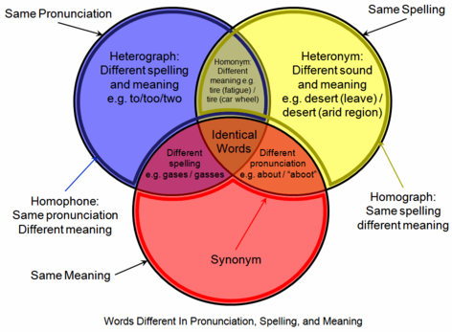
What about those other things?

Slide 4
So what do we have?
Homographs - same written form, different meanings
Heterographs - different written form, different meanings, same sound
Homophones - different meanings, same sound
Heterophones - different sound
Homonyms - same written form, different meaning, same sound
Heteronyms - same written form, different meaning, different sound
For simplicity, we’ll just call all of them homonyms

Slide 5
How about some examples?
The insurance was invalid for the invalid.
The buck does funny things when the does are present.
The bandage was wound around the wound.
He could lead if he would get the lead out.
Since there is no time like the present, he thought it was time to present the present.
The soldier decided to desert his dessert in the desert.

Slide 6
But I never have trouble with those…
You’re sure your bike is locked in the garage?
They’re taking their kids on vacation there.
I have certain everyday tasks to complete every day.
It is dangerous to break the brakes on a car.
People who sell shirts can wear their wares.
Does a bear have bare arms?

Slide 7
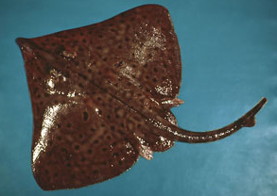
Why worry about them?
As a writer, your mission, should you choose to accept it, is to be as clear as possible about what you are saying (and you really should accept it)
Don’t leave things up to the reader to “figure out”
And a skate is flat and ugly (at least in my opinion)

